Slide 1
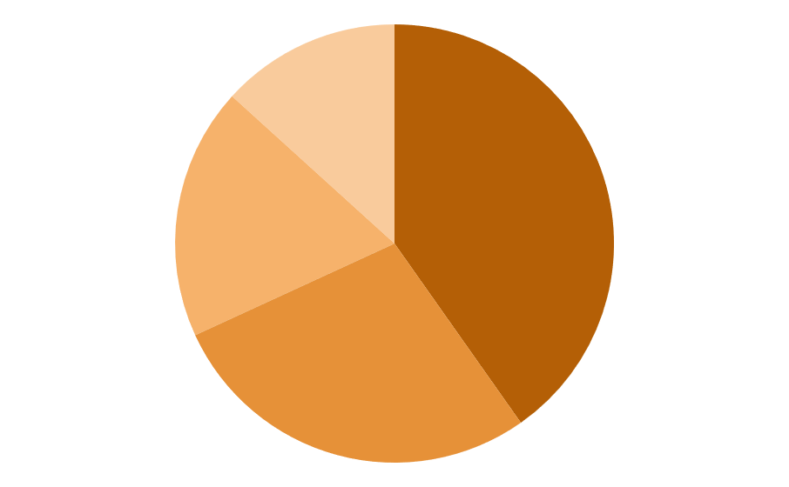
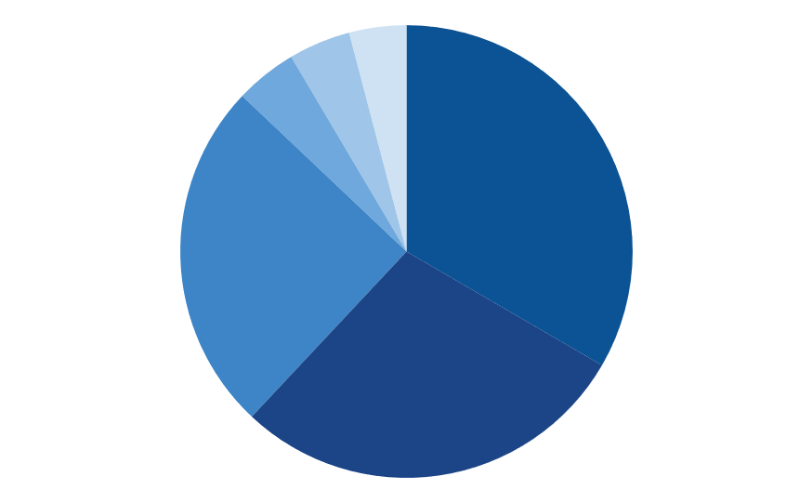
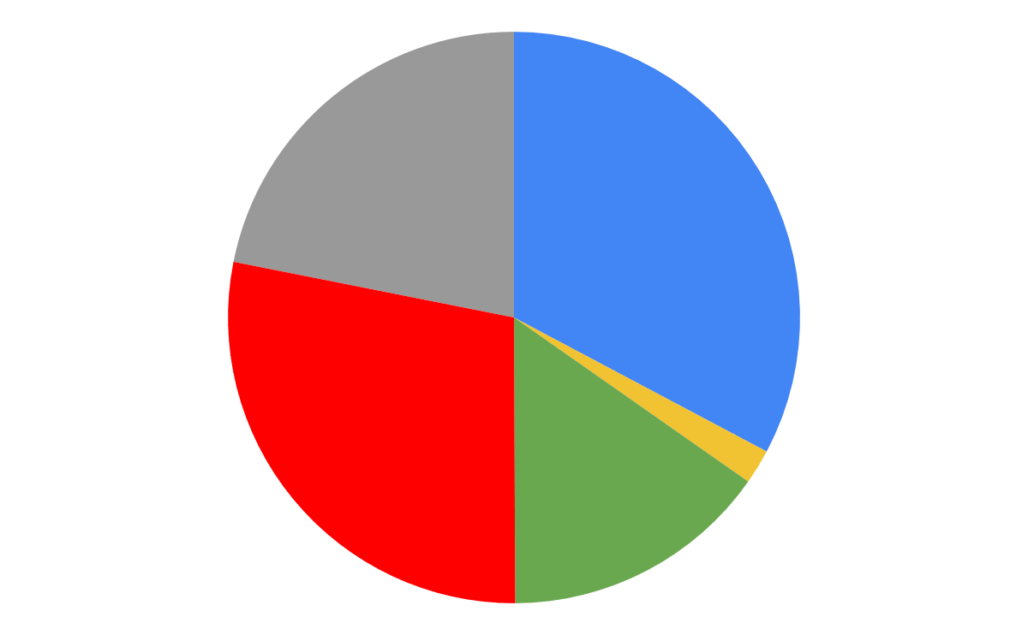

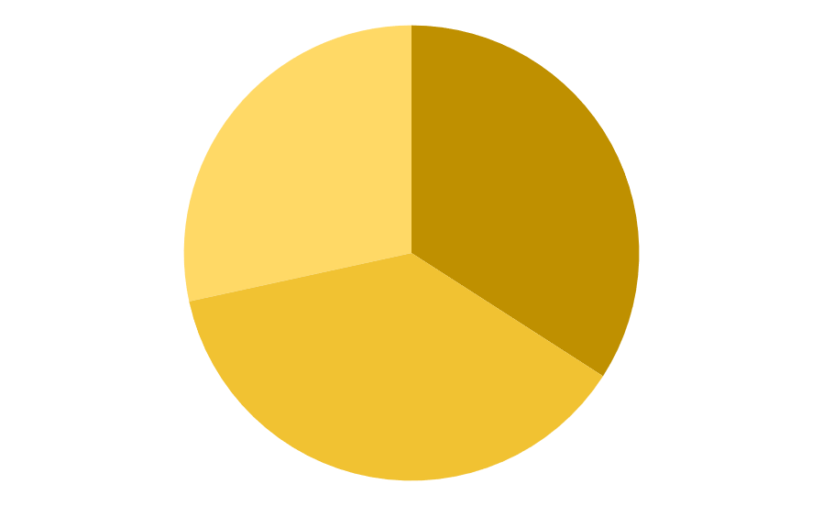
Previsionnal Expenses
Suspension Budget
Powertrain Budget
14 680€
12 630€
Steering system 13%
Fuel system 4%
Cooling system 4%
Intake system 5%
Engine & accessories 33%
Brake system 19%
Wheels and Tires 40%
46 400€
Exhaust system 25%
Secondary drivetrain system 29%
Dampers 28%
Miscellaneous 22%
33%
Electrical Budget
28%
2%
Frame Budget
880 €
6 810€
15%
Data acquisition 14%
Crash box
28%
Frame bending
34%
Other (ECU, Battery…) 24%
Financial provisions: 5 400€
electronic 30%
Gear Shift 25%
Paint
38%

Slide 2
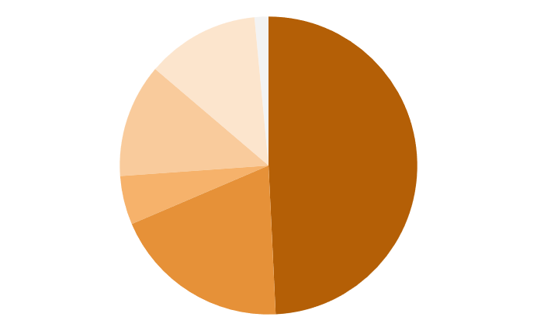
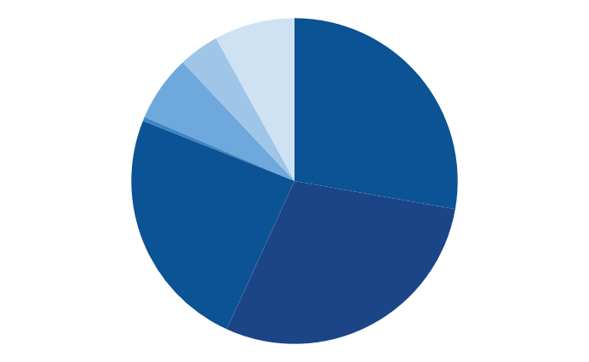
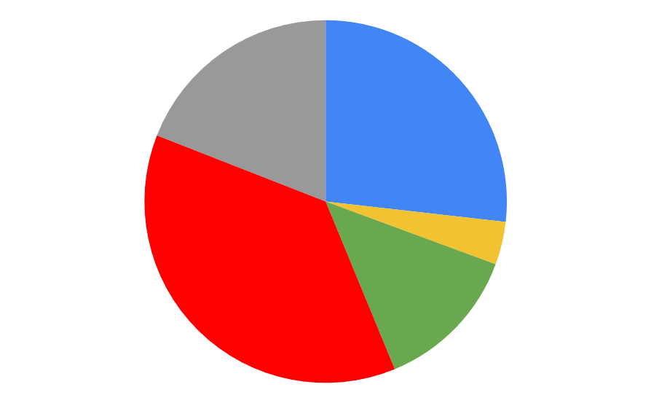
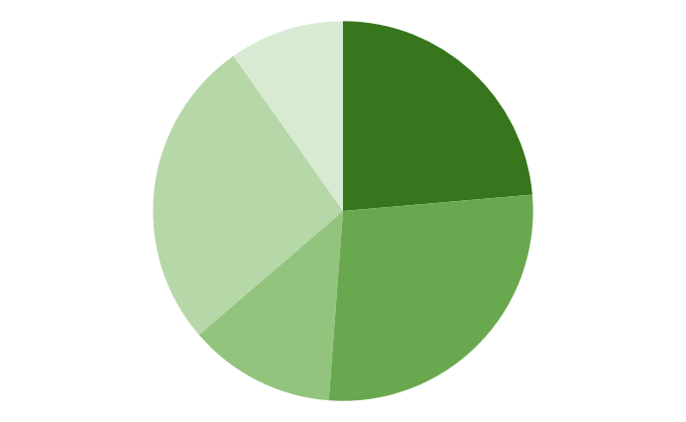

Overview Expenses
Suspension Budget
Powertrain Budget
14 046€
19 480€
A_arms 12%
Miscellaneous 2%
Miscellaneous 8%
Cooling system 4%
Engine & accessories 28%
Fuel system 7%
Steering system 12%
Intake system ≈0%
Wheels and Tires 49%
Brake system 5%
52 418€
Exhaust system 24%
Secondary drivetrain system 29%
Miscellaneous 19%
27%
Dampers 20%
Electrical Budget
37%
4%
Frame Budget
2 005 €
6 893€
13%
Miscellaneous 8%
Bodywork 26%
Rigidity tests
26%
Other (ECU, Battery…) 20%
Data acquisition 22%
Gear Shift 39%
Paint
22%
Frame 26%
Electronic 11%

